Slide 1


Embedded systems project vending machine
Princess Sumaya University for Technology
King Abdullah II Faculty of Engineering
Student name | Student ID | major
Dima Hussein | 20190581 | Computer engineering
Tarek Salameh | 20190217 | Computer engineering
Lina Abu-Ghosh | 20190876 | NIS engineering
Instructor: Dr. Belal Sababha
Group: 6

Slide 2
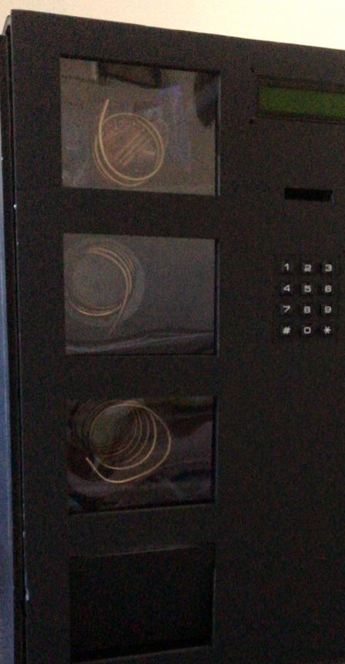
Introduction
Our project is a vending machine that takes two types of coins (5 and 50 quirsh) that will be detected using two IR sensors, in exchange for inquiring items .
we have three items each is carried by a coil that is connected to a stepper motor which releases the item if the amount of coins are equal or more.
The LCD is used to display the whole process starting with asking the user to select the item, displays it's price and process when the item has been chosen.
The Keypad is used to select the items and to do a manual reset if needed.

Slide 3
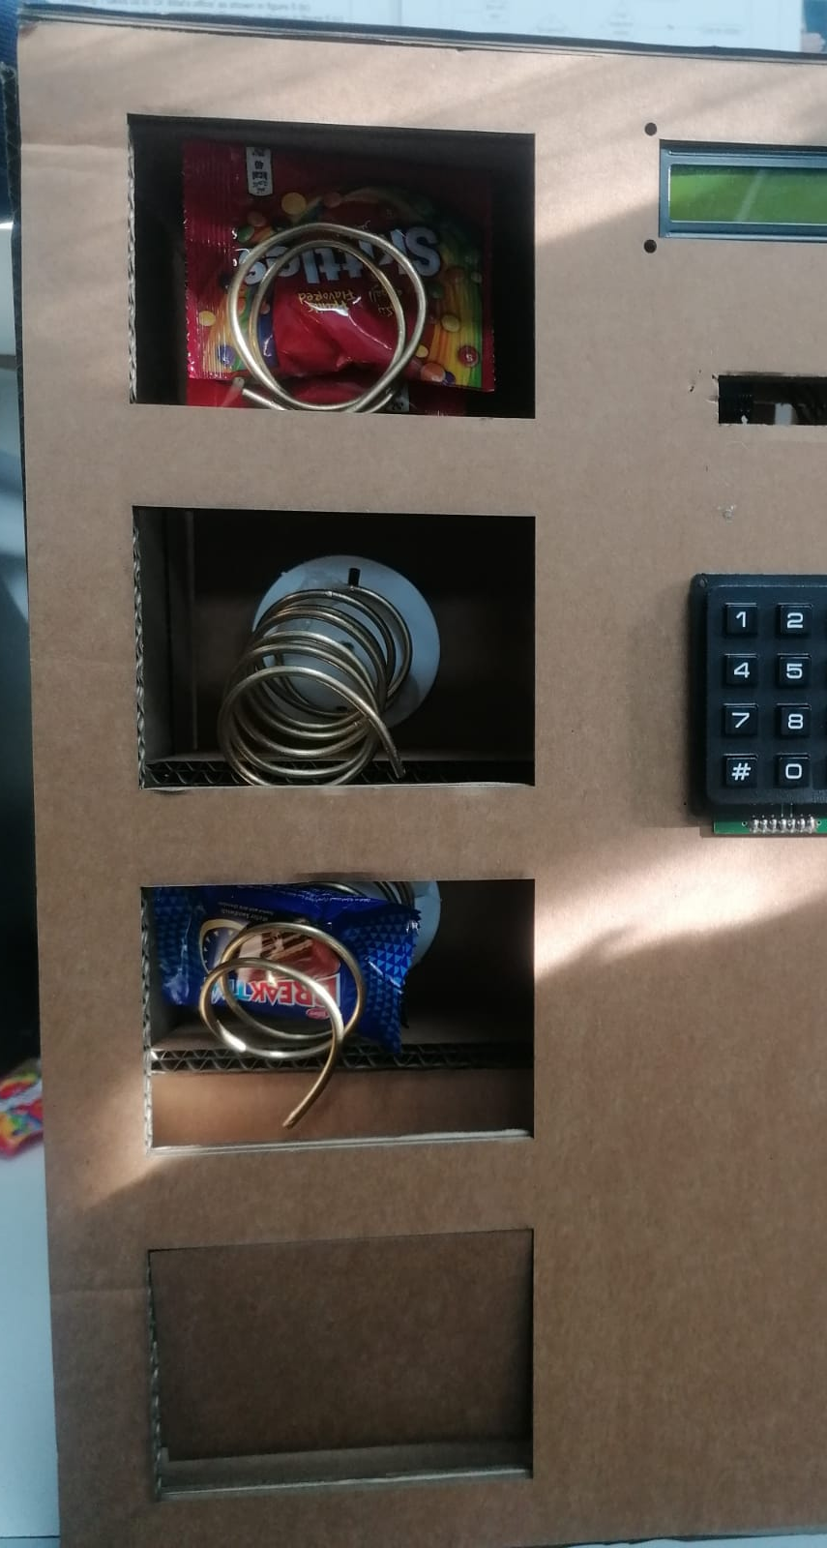
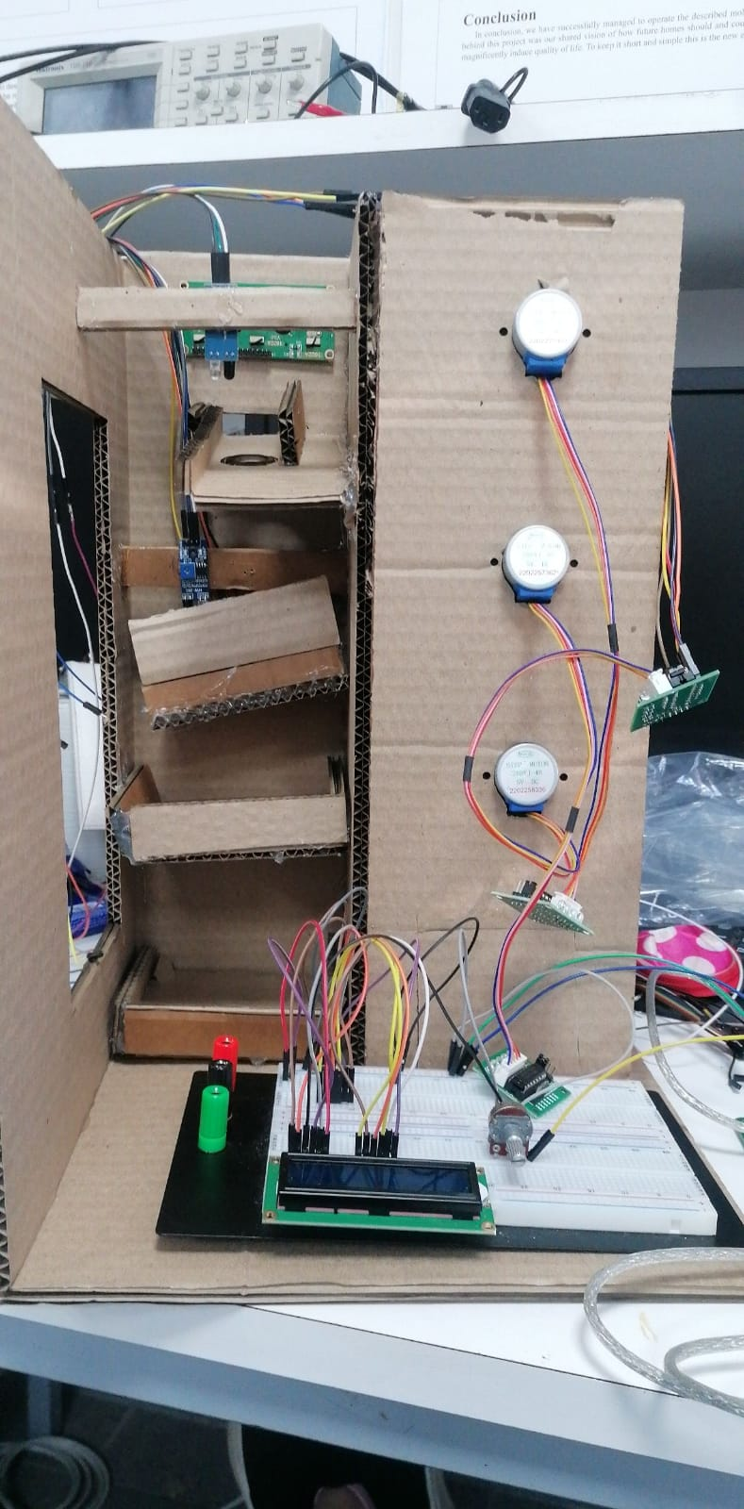
Stepper motor
Each motor is connected to a coil that carries an item, when a certain item is selected from the keypad, the motor rotates in specific amount of steps and in a certain speed to release the selected item.

Slide 4
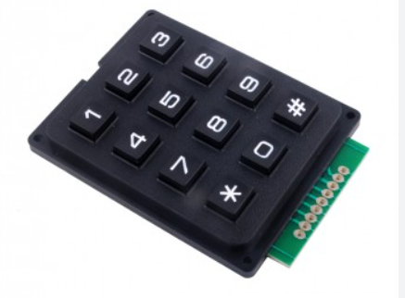
Keypad 4x3
Select the item:
1 --> item one price 5 qurish
2 --> item two price 50 quirsh
3 --> item three price 100 quirsh
*--> manual reset

Slide 5
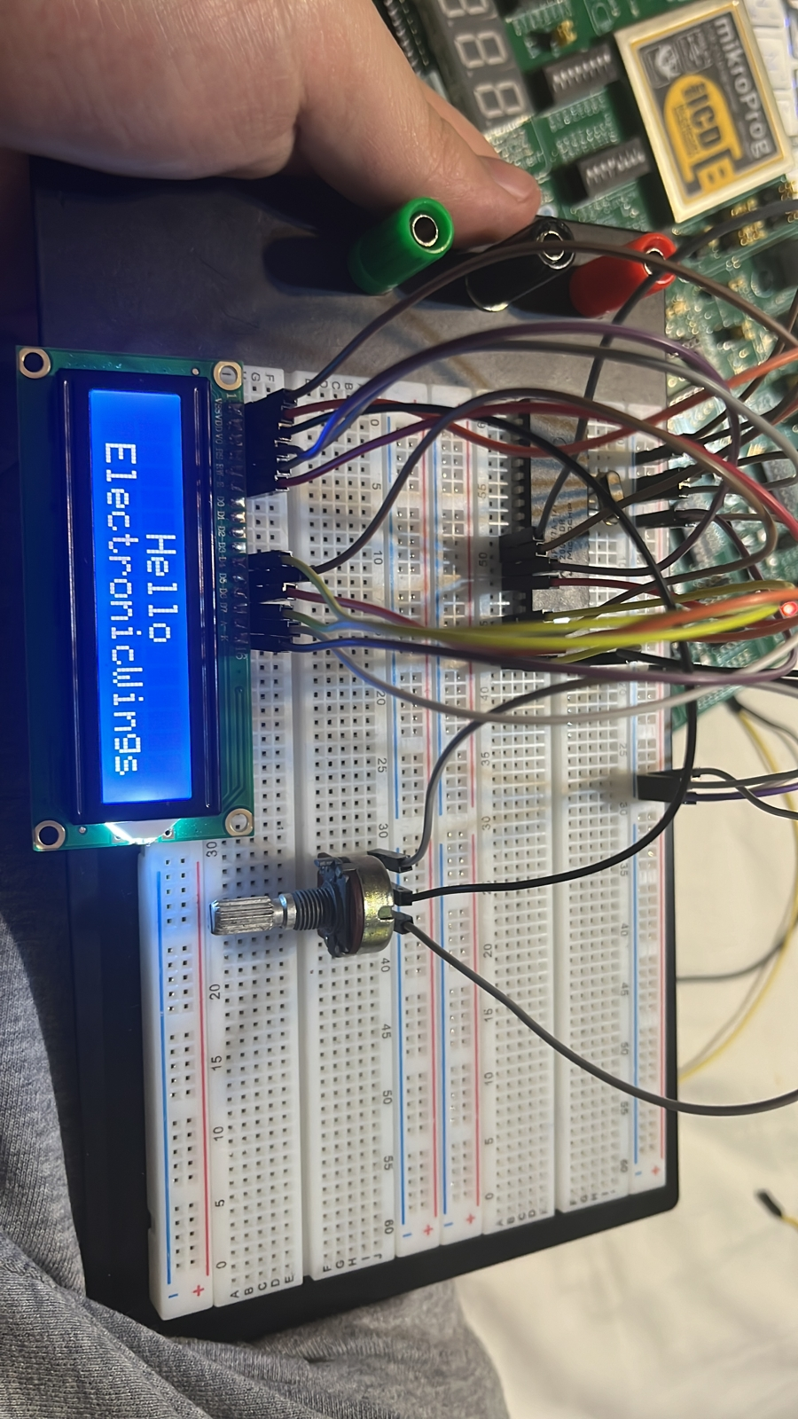
LCD 16x2
Displays the whole process of the vending machine
“Select(1,2,3):"
“Item(num): Price"
“Credits: Balance”
“Processing...”
And so on.

Slide 6
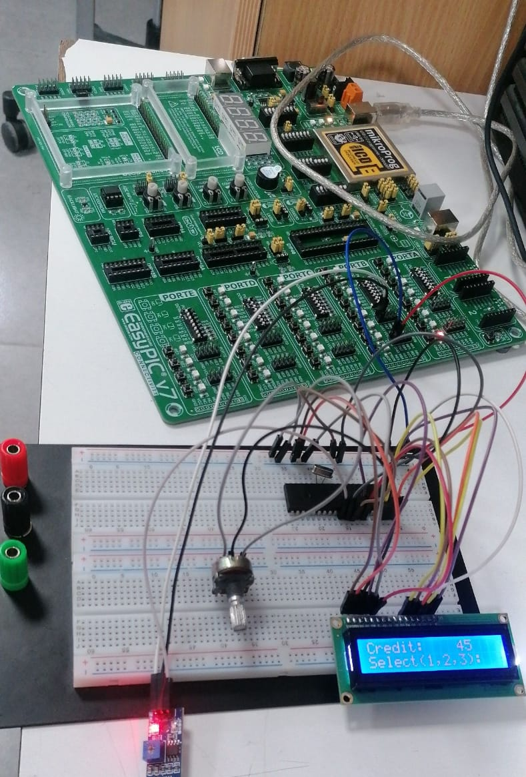
IR sensor: Reads and detects the coin when it's fetched.

Slide 7

Conclusion
Working with the 16F877A pic microcontroller to build a small vending machine needs a big effort and time depending on the functionality of the machine and the types of motors and sensors.
But in general the most important part is the code and you need to know how to connect the motors and the sensors individually to the easypic and to the breadboard and then connecting the whole hardware together.

